Slide 1

Shopping Trends Analysis

Slide 2

Indroduction
In this presentation we will explore the data on Shopping Trends.
Our objective is to give ideas for the growth of the company by analyzing the data

Slide 3
Description
Customer ID - Unique identifier for each customer
Age - Age of the customer
Gender - Gender of the customer (Male/Female)
Item Purchased - The item purchased by the customer
Category - Category of the item purchased
Purchase Amount (USD) - The amount of the purchase in USD
Location - Location where the purchase was made
Size - Size of the purchased item
Color - Color of the purchased item
Season - Season during which the purchase was made
Review Rating - Rating given by the customer for the purchased item
Subscription Status - Indicates if the customer has a subscription (Yes/No)
Shipping Type - Type of shipping chosen by the customer
Discount Applied - Indicates if a discount was applied to the purchase (Yes/No)
Promo Code Used - Indicates if a promo code was used for the purchase (Yes/No)
Previous Purchases - The total count of transactions concluded by the customer at the store, excluding the ongoing transaction
Payment Method - Customer's most preferred payment method
Frequency of Purchases - Frequency at which the customer makes purchases (e.g., Weekly, Fortnightly, Monthly)

Slide 4
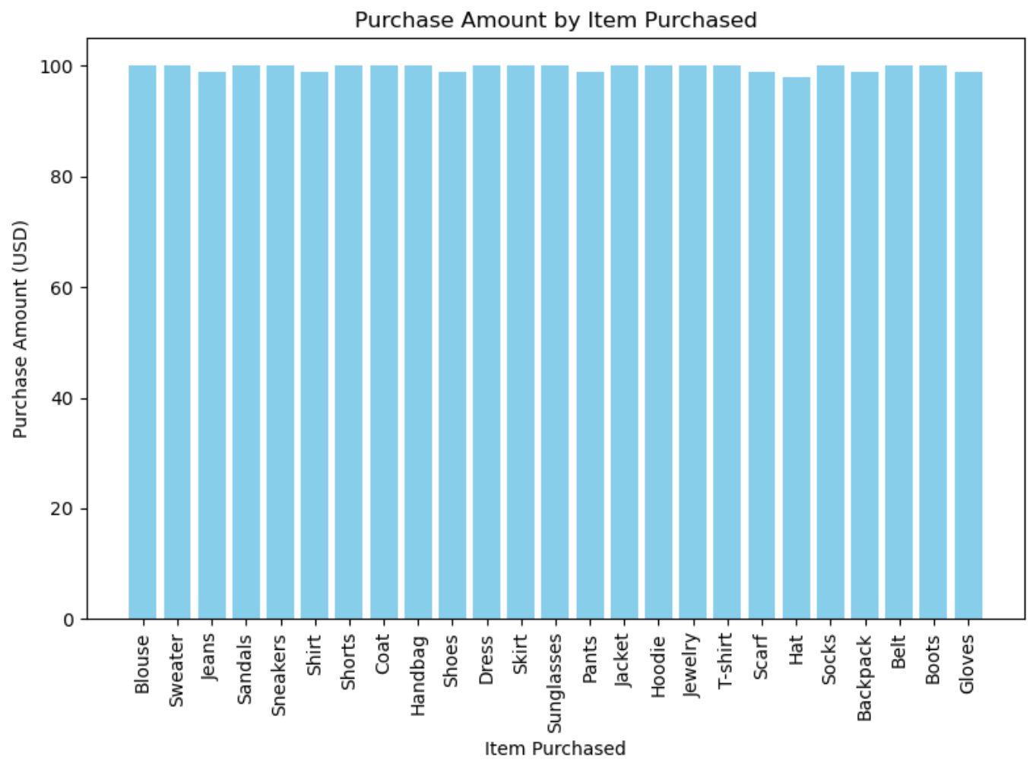
This plot shows the purchase amount over item.

Slide 5
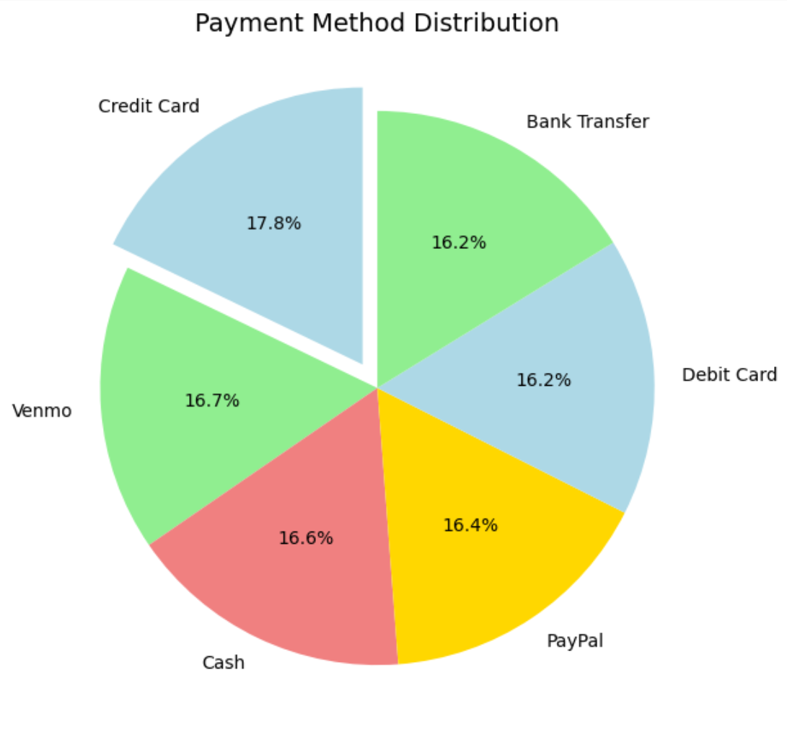
This chart shows the distribution of payment method.

Slide 6
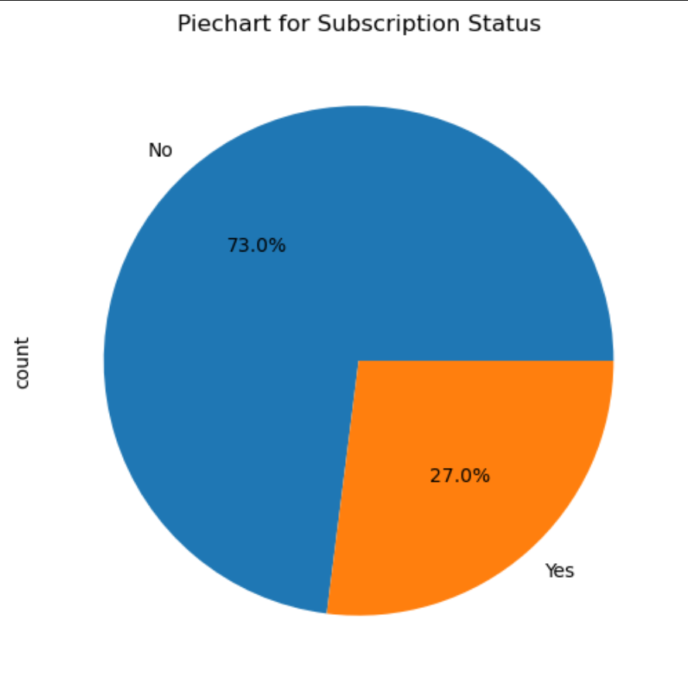
This chart shows the subscription distribution.

Slide 7
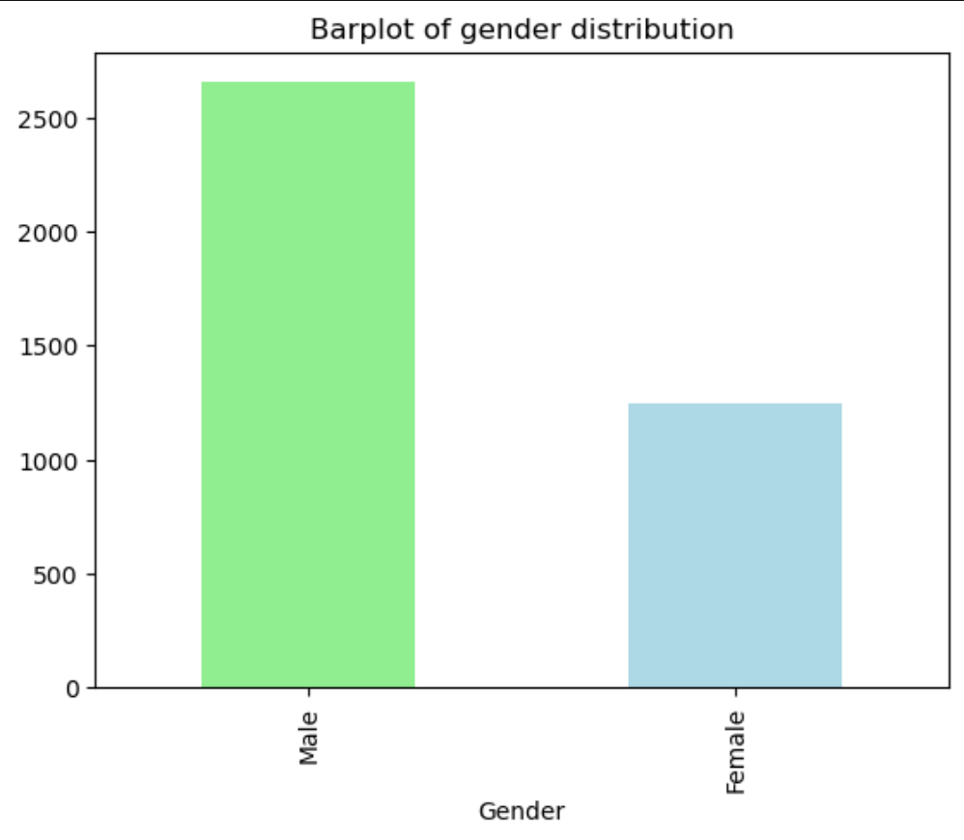
This plot gives the count of Male and Female customers.

Slide 8
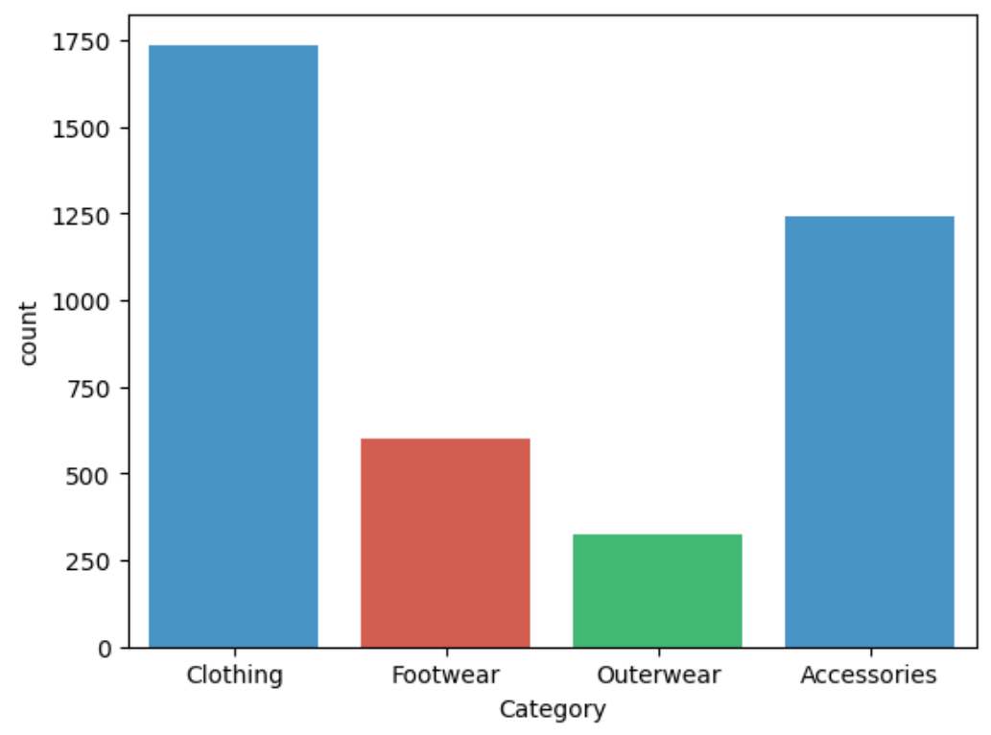
This plot shows the count of different clothing category.

Slide 9
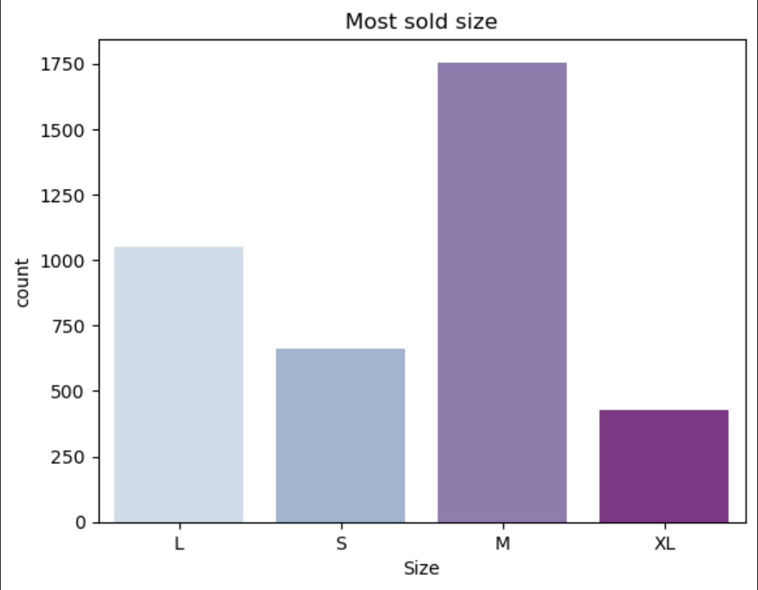
This plot shows the most sold size count.

Slide 10
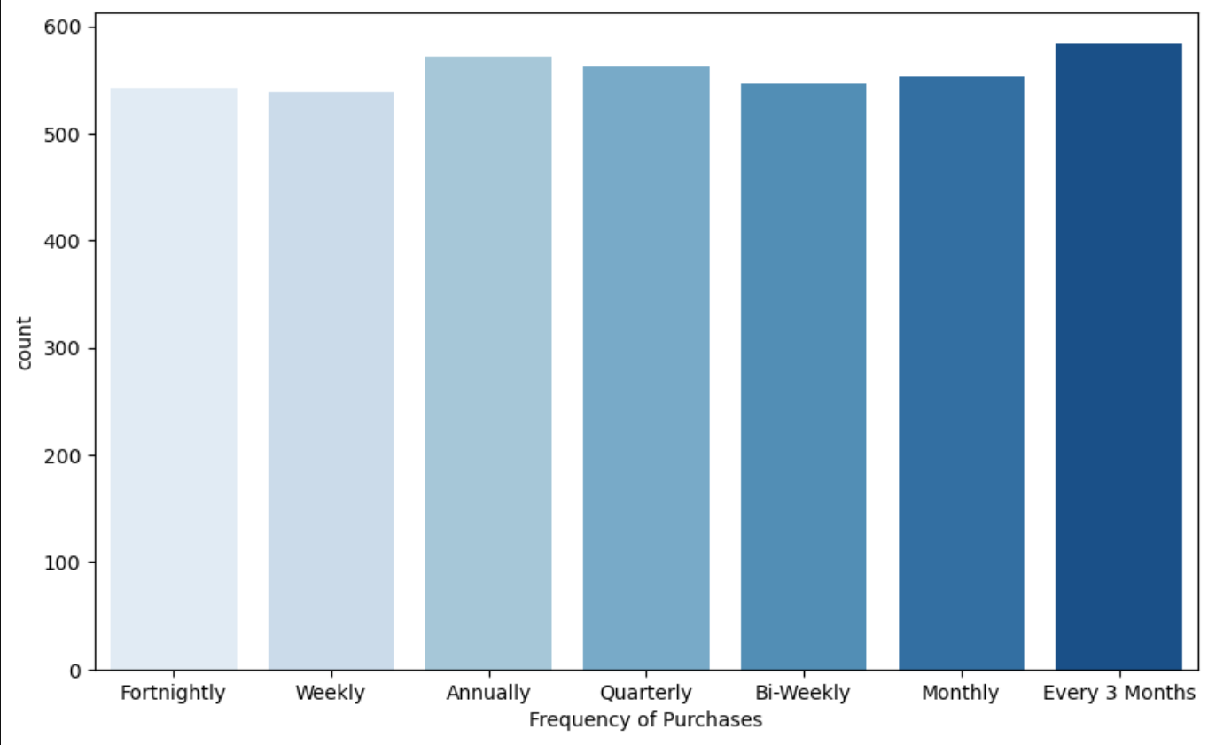
This plot shows the Frequency of purchases.

Slide 11
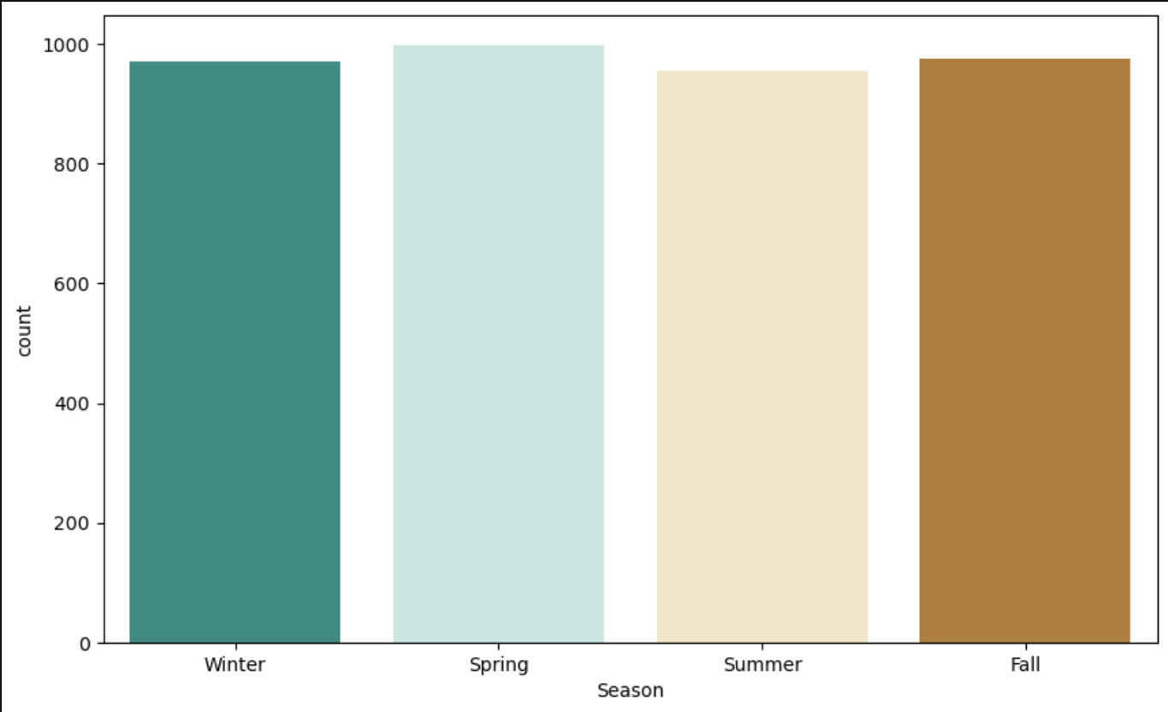
This plot shows the purchase count over season.

Slide 12
Conclusion
Most oftenly customer purchases by using CreditCard by giving special offers for CreditCard purchasing will make a positive growth.
Most of the customers are not taking subscription this can be resolved by either reducing subscription amount or giving gifts over subscription.
Most of the purchases are made by Male. To increase Female customers female products should be increased and it should be promoted in proper manner.
In Spring season there is slight increase purchases so increasing the product in spring can make a positive growth.
Both Male and Female customers are purchasing clothing category largly.
Proper improvement should be given to other categories for positive growth.

Slide 13
THANK YOU

